Slide 1

CROSS-UTILITY SMART CAMPUS RESOURCE MONITOR: INTEGRATED ENERGY COMPETITION AND WATER LEAKAGE DETECTION
Supervisors
DR. C. SIVASANKAR
Presented by
I. MD IMTHIAZ(192521360)
G SAI DEEPAK(19231142)
CSA0925 – Programming in Java

Slide 2


PROBLEM BACKGROUND
Application Domain
Smart Campus Management
Energy and Water Resource Management
IoT-Based Utility Monitoring
Need for the Project
Integrate energy and water monitoring into one platform.
Detect abnormal water-flow patterns.
Provide timely maintenance alerts.
Encourage energy-efficient behaviour through hostel rankings.
Current Scenario
Campus utilities such as electricity and water are often monitored separately.
Different utility systems may result in fragmented information.
Abnormal water usage may not be identified immediately.
Energy conservation can be improved through user engagement and competition.
Target Users
Campus Administrators
Hostel Wardens
Maintenance Staff
Campus Management

Slide 3
PROBLEM STATEMENT
Problem Definition
Smart campus initiatives generally monitor individual utilities separately, resulting in fragmented dashboards and limited cross-utility insights. An integrated system is required to monitor energy and water usage, identify abnormal water-flow patterns, and encourage energy efficiency through gamification.
Limitations of Current Systems
Separate monitoring of individual utilities
Lack of unified dashboard
Delayed identification of water leakage
Limited visibility into abnormal water consumption
Lack of motivation for energy conservation
Expected Impact
Improved utility monitoring
Faster identification of possible leaks
Better energy-management awareness
Improved resource conservation
Centralized campus utility information

Slide 4
OBJECTIVE
Primary Objective
To develop an integrated smart campus resource monitoring system that combines energy monitoring, water leakage detection, and gamified energy-efficiency comparison.
Project Scope
Hostel-level utility monitoring
Water-flow analysis
Leak/anomaly alerts
Energy-efficiency leaderboard
Centralized dashboard
Specific Objectives
To collect energy consumption and water-flow data from hostel blocks.
To monitor utility usage through a centralized system.
To identify abnormal water-flow patterns indicating possible leakage.
To generate alerts for detected water anomalies.
To rank hostel blocks based on energy efficiency.

Slide 5


BLEM STATEMENT
LITERATURE REVIEW
No. | Year | Research Area | Approach | Limitation
1 | 2026 | Smart Campus Energy Management | Energy management and cloud-based architecture | Mainly energy-focused
2 | 2025 | Campus Electricity Management | Smart campus electricity monitoring and behaviour analysis | Requires smart-meter infrastructure
3 | 2025 | Smart Campus Energy Management | AI-supported energy optimization | Focuses mainly on energy
4 | 2024 | Water Leakage Detection | Deep learning and CFD-based leak detection | Computationally complex
5 | 2024 | Water Leakage Detection | Digital twin + transformer-based prediction | Complex infrastructure
Research Gap
Existing systems mainly focus on individual utilities or require complex hardware/AI infrastructure. There is a need for a lightweight software-based platform that integrates utility monitoring, water-usage anomaly detection, and gamified energy-efficiency comparison in one campus system.

Slide 6
EXISTING VS PROPOSED
Comparison
Advantages
Centralized utility monitoring
Early identification of abnormal water usage
Automated alerts
Hostel-wise energy ranking
Unified dashboard
Better resource-management decisions
Feature | Existing System | Proposed System
Utility Monitoring | Separate systems | Unified software platform
Energy Monitoring | Basic/separate | Centralized tracking
Water Monitoring | Separate | Integrated monitoring
Leakage Detection | Manual/delayed | Software-based anomaly detection
Dashboard | Fragmented | Single dashboard
Energy Competition | Not integrated | Hostel leaderboard
Alerts | Limited/manual | Automated alerts
Cross-Utility Analysis | Limited | Combined analysis
Novelty
Integration of utility monitoring, water-usage anomaly detection, and gamified energy-efficiency comparison within a single software-based campus management platform.

Slide 7
REQUIREMENTS
Functional Requirements
User/Admin login
Hostel management
Electricity data entry
Water data entry
Utility usage monitoring
Water anomaly detection
Leak alert generation
Energy-efficiency calculation
Hostel ranking
Dashboard
Report generation
Non-Functional Requirements
Performance
Reliability
Security
Usability
Scalability
Maintainability
Data Requirements
Hostel details
Electricity consumption
Water consumption
Historical usage
Alert records
Energy-efficiency scores
Dataset / APIs
Dataset: Software-generated / manually entered utility data
External APIs: Not required
Software Requirements
Programming Language: Java
GUI: Java Swing / JavaFX
Database: MySQL
Connectivity: JDBC
IDE: IntelliJ IDEA / Eclipse / NetBeans
OS: Windows
6

Slide 8
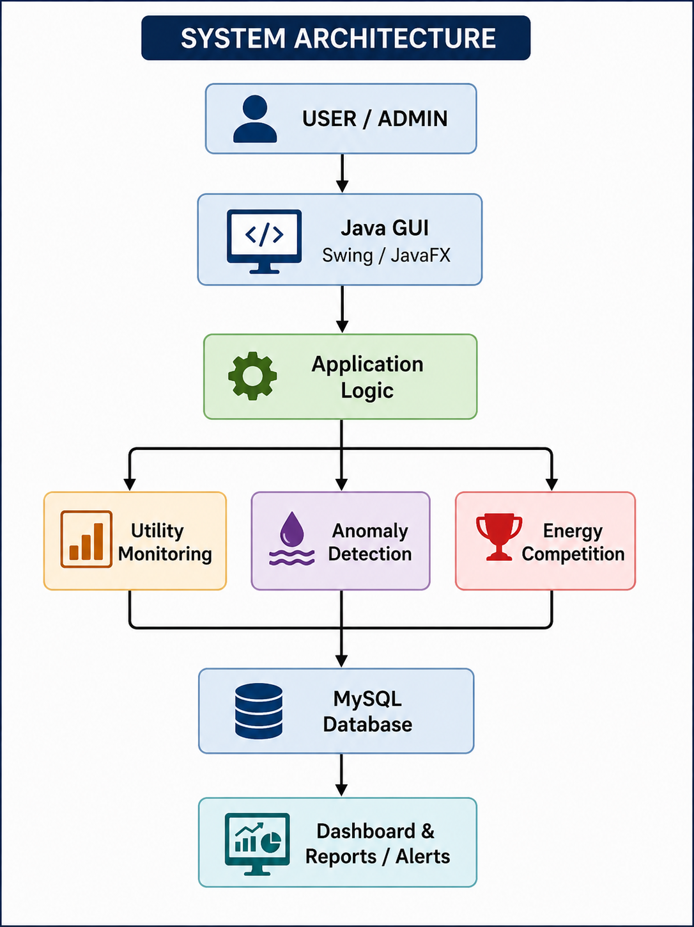
SYSTEM ARCHITECTURE
Workflow
Data Entry → Database → Analysis → Anomaly Detection → Alerts & Ranking → Dashboard
Module Description
1. Utility Monitoring Module
Records electricity and water usage.
2. Leak Detection & Anomaly Alert Module
Analyze water-usage patterns.
Detects abnormal consumption.
Generates alerts.
3. Gamified Energy Competition Module
Calculates energy efficiency.
Ranks hostel blocks.
Displays leaderboard and rewards.
7

Slide 9
PLANNING
Risk Analysis
Work Breakdown Structure (WBS)
Problem Identification
Literature Survey
Requirement Analysis
System Design
Database Design
UI Design
Java Application Development
Utility Monitoring Module
Water Anomaly Detection Module
Energy Competition Module
Testing
Documentation
Milestones
Literature Survey Completed
Requirement Analysis
UI Design
Database Completion
Utility Monitoring Module
Water Anomaly Detection Module
Energy Competition Module
Final Testing
Documentation
Risk | Solution
Incorrect utility data | Data validation
Database errors | Regular backup
Anomaly detection errors | Threshold testing
Application errors | Modular testing
Data entry delay | Multiple authorized users
Performance issues | Database optimization

Slide 10
EXPECTED OUTCOMES & REFERENCES
Expected Deliverables
Java-based utility monitoring application
Centralized dashboard
Water anomaly detection system
Automated alert mechanism
Energy-efficiency leaderboard
MySQL database
Reports
Project documentation
Expected Benefits
Centralized utility monitoring
Faster identification of abnormal water usage
Improved energy awareness
Better resource management
Encouragement of energy conservation
Data-driven maintenance decisions
IEEE References
R. K. Mondal, “Smart Campus Energy Management System,” SVU Press, 2026, pp. 67–79.
Y. Shen and J. Gao, “Campus Electricity Smart Management System,” Proc. ICAIPD, 2025, pp. 45–50.
A. Manassra and G. Işık, “AI-Supported Energy Management in Smart Campuses,” Journal of Smart Systems Research, 2025.
C. Pandian and P. J. A. Alphonse, “Deep Learning for Water Leak Detection,” Discover Computing, vol. 27, 2024.
T. A. Syed et al., “Smart Water Management with Digital Twins,” Water, vol. 16, 2024.
Expected Outcome
A unified software platform for monitoring campus utility usage, detecting abnormal water consumption, and promoting energy efficiency through hostel-level competition.

Slide 11


